Slide 1
CS 5/7330
File structures

Slide 2
File structures for relational databases
Relational database
A set of tables
Each table has a set of tuples (records)
Assumption:
Data are stored in files
Files are stored on disk
Data on files are divided into fixed size blocks (pages)
For now, assume each table corresponds to a file

Slide 3
File structures for relational databases
Each table has a set of tuples / records
Each tuple is make up of a fix set of attributes
Attributes have types, which require bytes to store
E.g. integer – 4 bytes,
Some types allow variable length
E.g. VARCHAR,
But VARCHAR(50) can be viewed as fixed size of 50
Thus tuples can be of fixed or variable length

Slide 4
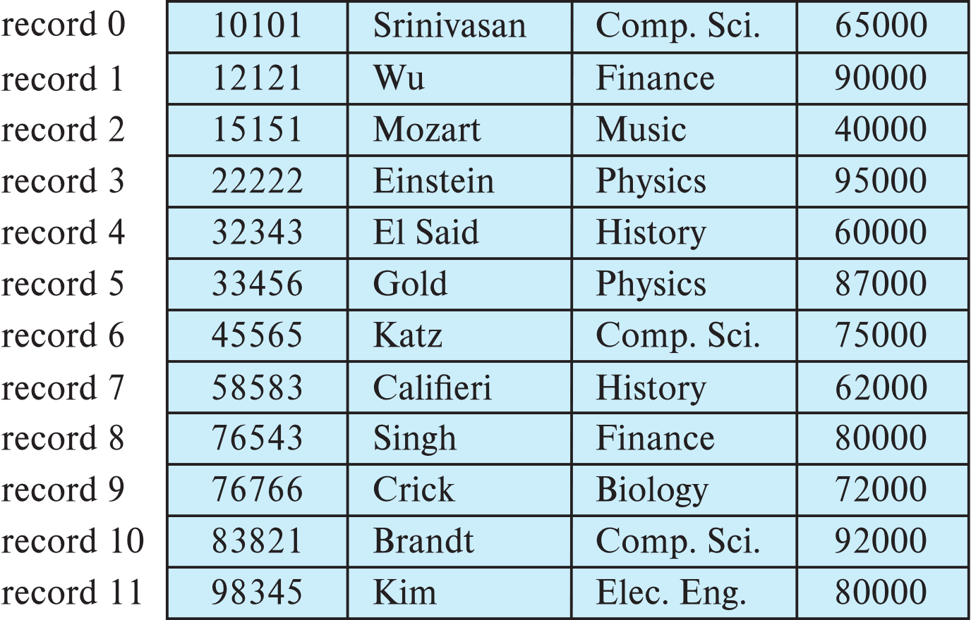
Page structure: Fixed length records
Assume each record requires n bytes
Store record i starting from byte n ∗ (i – 1), where n is the size of each record.
Each record has a number associated with it
What other bookkeeping info is needed?
Problem of this approach?

Slide 5
Fixed length records
Problem 1 : Records may pass page boundaries
E.g. A page has 100 bytes, each record has 12 bytes
Record number 9 will pass two pages
What’s the problem with that?
Solution, limit size so no record cross boundaries:
E.g. in the previous case, each page can only store floor(100/12) = 8 records
Trade-off: internal fragmentation

Slide 6
Fixed length records
Insert a record
Just add a record at the end of the file
Delete a record
3 options
Shift all records up a slot
Shift the last record to fill in a page
Other solutions?
For the first 2 cases, do not shift record across pages (why?)

Slide 7
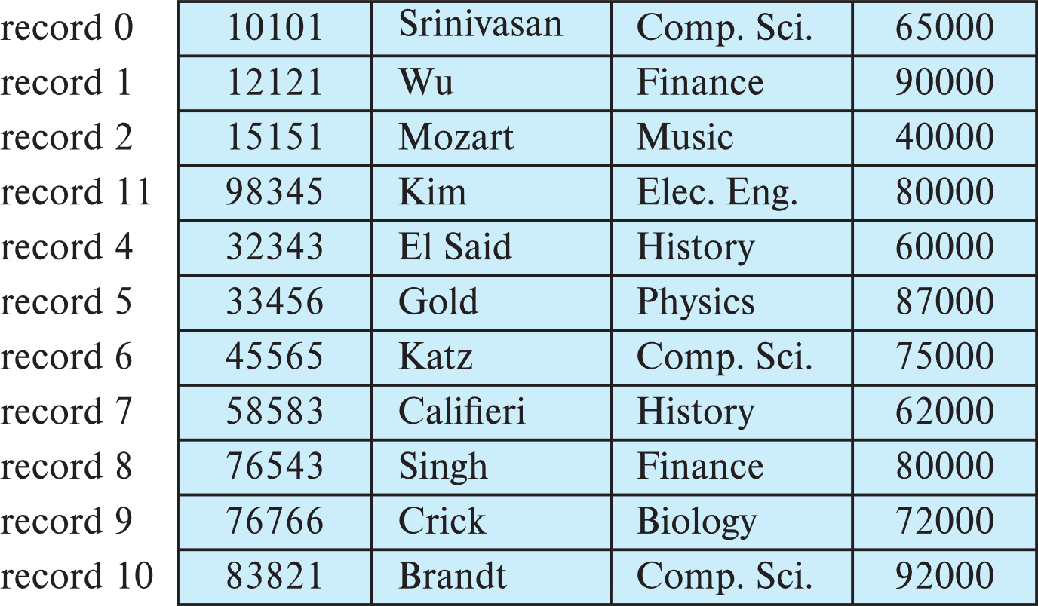
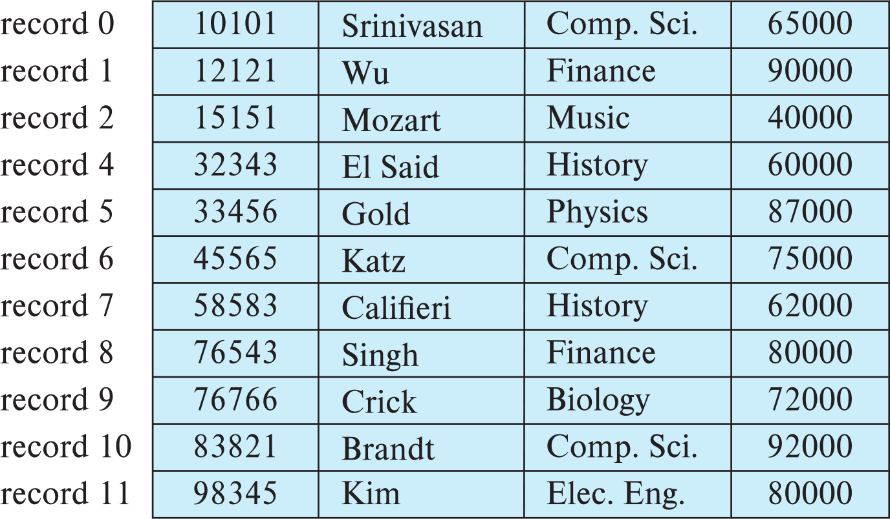
Move the last
Shift everything up 1

Slide 8
Fixed length records
Third solution
Do not move records, but create a free record list
Book-keeping info
For each record, need a pointer pointing to the first free record
Each free block will need to have a designation that it is free
And a pointer pointing to the next free record
Also a way to denote end of the list
Advantages / Disadvantages?

Slide 9
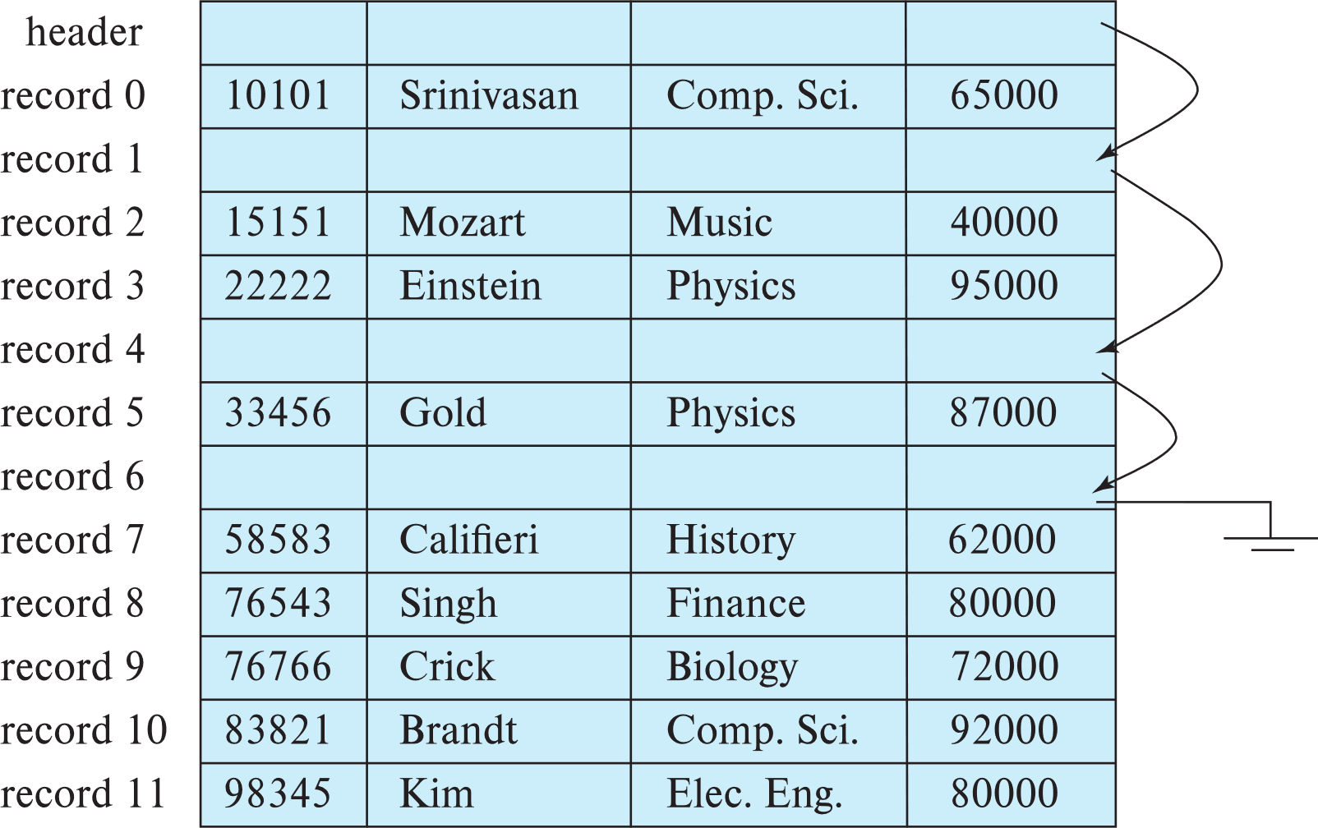

Slide 10
Page structure: Variable length record
Cannot predict how many records are there in a page
And each page can be of variable length
Solution
A slotted page header containing
# of records in that page
The starting location and size of each record
Why do we need size?
Notice that typically we put a limit on number of records
Records can be moved around within a page to keep them contiguous with no empty space between them; entry in the header must be updated.

Slide 12
Large objects (Blobs)
Records must be smaller than pages
Alternatives:
Store as files in file systems
Store as files managed by database
Break into pieces and store in multiple tuples in separate relation
PostgreSQL TOAST

Slide 13
Organization (ordering) of records
How should records in a file be organized (ordered)?
One file per table:
Heap – record can be placed anywhere in the file where there is space
Sequential – store records in sequential order, based on the value of the search key of each record
With indexing option:
B⁺-tree file organization
Ordered storage even with inserts/deletes
Hashing – a hash function computed on search key; the result specifies in which block of the file the record should be placed
Multiple tables per file:
In a multitable clustering file organization records of several different relations can be stored in the same file
Motivation: store related records on the same block to minimize I/O

Slide 14
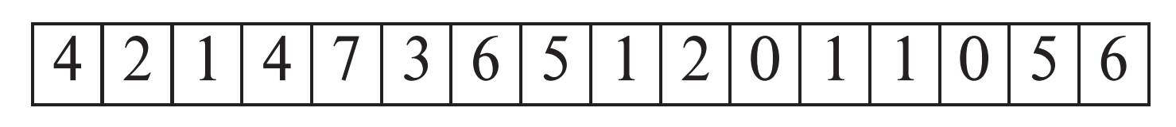
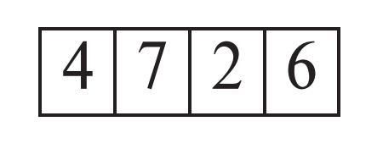
Heap file
Records can be placed anywhere in the file where there is free space
Records usually do not move once allocated
Important to be able to efficiently find free space within file
Free-space map
Array with 1 entry per block. Each entry is a few bits to a byte, and records fraction of block that is free
In example below, 3 bits per block, value divided by 8 indicates fraction of block that is free
Can have second-level free-space map
In example below, each entry stores maximum from 4 entries of first-level free-space map
Free space map written to disk periodically, OK to have wrong (old) values for some entries (will be detected and fixed)

Slide 15
Sequential file
Suitable for applications that require sequential processing of the entire file
The records in the file are ordered by a search-key
We sometime call this organization clustered via a search-key

Slide 16
Sequential file
Deletion – use pointer chains
Insertion –locate the position where the record is to be inserted
if there is free space insert there
if no free space, insert the record in an overflow block
In either case, pointer chain must be updated
Need to reorganize the file from time to time to restore sequential order

Slide 17
Heap File vs. Sequential File
What’s the difference?
Heap file:
Relatively little insertion cost
Sequential file:
Cost involved when insertion (to maintain sorted)
Or have to sort every time (expensive)
So why even think about sequential file?
It helps with some queries

Slide 18
Heap File vs. Sequential File
Example: (used for the rest of the slides)
Two tables
Department(dept_name, building , budget)
Assume each tuple is 40 bytes
Dept_name is key
Instructor(id, name, dept_name, salary)
Assume each tuple is 50 bytes
Id is key, dept_name is foreign key (referencing Department)
Assume data are stored on disk
Each page has 1050 bytes
Assume 50 bytes are needed for overhead information
Assume the pages are fully filled
Now assume Department has 100,000 tuples
So number of pages = 100,000 * 40 / (1050-50) = 4,000 pages
Assume Instructor has 400,000 tuples
So number of pages = 400,000 * 50 / (1050 – 50) = 20,000 pages

Slide 19
Heap File vs. Sequential File
Now consider the following query
SELECT * FROM Instructor where id = “1997”
Now if you have a heap file
You have to look for each tuple
You can stop when you find the tuple (why?)
Worst case: no instructor has such ID
In this case, you have to search the whole file
Total cost = 20,000 pages
However, if Instructor table is sorted via id:
Then can apply binary search
Total cost =ceiling( log₂(20000) ) = 15 pages

Slide 20
Heap File vs. Sequential File
Now consider the following query
SELECT * FROM Instructor where id = “1997”
However, for magnetic disk, we need to worry about seek/rotation
For binary search, subsequent searches are not on consecutive pages
Thus need rotate (or even seek)
Now suppose reading a page take s seconds, and a rotate/seek take 100s second
Then time for heap file = 100s + 20000s (1 seek + 20000 read) = 20100s
Time for sequential file = 100s + log₂20000 *(100s + s) = (1 seek + 15 rotate and read) = 1512s
Still win, but not as big a gap

Slide 21
Heap File vs. Sequential File
Now consider the following query
SELECT * FROM Instructor where id = “1997”
What is the file is smaller (e.g. 400 pages)
Then time for heap file = 100s + 400s = 500s
Time for sequential file = 100s + ceiling( log₂(400) ) *(100s + s) = 706s
Binary search on sequential file is not worth it

Slide 22
Heap File vs. Sequential File
Now consider the following query
SELECT * FROM Instructor where salary > 1000
Sorting through ID will not help
In either case, one MUST read the whole file no matter what
Sequential file doesn’t help

Slide 23
Addition: How to sort a file
Suppose you do want to sort a file on the disk
And store the results on the disk
E.g. SELECT * from instructor ORDER BY salary
Simple solution
Read the whole file into main memory
Sort it using your favorite sorting algorithm
Write the whole file back to the disk
What if the file is too large to fit into main memory?

Slide 24
Addition: How to sort a file
What if the file is too large to fit into main memory?
Remember comparing value can only occur when both tuples are in main memory
So we cannot just do a one pass sorting
Sorting need to be done in stages
Merge sort

Slide 25
Sorting a file: Merge sort
Merge sort
Start by breaking tuples into list of one tuple
At each iteration, merge pairs of list until half the list remains
Repeat until all lists are merged
We use the same basic algorithm but with some modification

Slide 26
Sorting a file: Merge sort
Assumptions
We have a file with N pages
We have B pages of main memory available (B < N)
Number of pages read/written are the main cost (we assume sorting in main memory is much faster that the time can be ignored)

Slide 27
Sorting a file: Merge sort
Step 1: Creating the initial list
Instead of creating list of one tuples, we can use the amount of main memory available
So read B pages from the file at a time
In the memory, sort the B pages using any efficient sorting algorithms
Write the B pages back to the disk somewhere
Repeat until every page is read and written
Total page read/written for this step = 2N
Each page is read/written once
At the end of this step: ceiling(N/B) list is formed, each (possibly except the last one, have length B)

Slide 28
Sorting a file: Merge sort
Step 2: Merging 2 lists
Divide the B pages of main memory into two groups
Pick 2 list, read the first part of one list into one group, and the first part of the second list into the other
Use the standard merge function in mergesort to merge
Need to write the merged page to the disk along the way (unless there is output buffer available)
When one list is exhausted, than read the rest of the list
Time for an iteration = 2N (once again, each page is read and written once)

Slide 29
Sorting a file: Merge sort
Step 3: Until done
The total number of iterations = ceiling(log₂(N/B))
So the total page read/written
2 * (1 + ceiling(log₂(N/B))) * N

Slide 30
Sorting a file : Merge Sort (example)
Suppose you have a file with 12,800 pages
Assume you have 200 page of memory available.
First step:
Read the first 200 pages of the file into main memory
Sort it
Write the sorted list somewhere on the disk (on consecutive blocks)
At the end of the first step, there are a total of 12,800 / 200 = 64 sorted segments, each of them contains 200 pages

Slide 31
Sorting a file : Merge Sort (example)
Second step
Put the 64 segments into groups of 2 (32 groups)
For each group, apply the merge algorithm in merge sort
However need to remember merging can be done only when data is in main memory
So for each group
Divide the main memory equally into 2 part (100 page each)
Read the first 100 page of each segment
Apply the merge algorithm, until one of the segment (100 page) is used up
Then read in the rest of that segment into the main memory and continue
Continue merging (if the first 100 of the other segment is used up), bring in the next 100 page
Until one of the segments is completely merged
Then write the rest of the remaining segment to the disk
Now a sorted segment of 200 + 200 = 400 pages is formed
Repeat for all groups, so now we have 32 sorted segments, each with 400 pages

Slide 32
Sorting a file : Merge Sort (example)
Third step (next iteration)
Put the 32 segments into groups of 2 (16 groups)
For each group, apply the merge algorithm in merge sort
However need to remember merging can be done only when data is in main memory
So for each group
Divide the main memory equally into 2 part (100 page each)
Read the first 100 page of each segment
Apply the merge algorithm, until one of the segment (100 page) is used up
Then read in the next 100 pages of that segment into the main memory and continue
Continue merging (whenever one of the 100 pages part of a segment is used up), bring in the next 100 page
Until one of the segments is completely merged
Then write the rest of the remaining segment to the disk
Now a sorted segment of 400 + 400 =800 pages is formed
Repeat for all groups, so now we have 16 sorted segments, each with 800 pages

Slide 33
Sorting a file : Merge Sort (example)
Subsequent steps (continued)
Merge 16 segments of 800 pages by pairs , forming 8 segments of 1600 pages
Merge 8 segments of 1600 pages by pairs, forming 4 segments of 3200 pages
Merge 4 segments of 3200 pages by pairs, forming 2 segments of 6400 pages
Merge the 2 remaining segments, forming 1 sorted file

Slide 34
Sorting a file: Merge sort
Modification:
Since we have B buffers available
We can actually merge more than 2 list at a time
In the extreme, we merge B-1 list at each step
Pick B-1 list
Assign one page in main memory to each list
Read the first page of each list into the corresponding memory
Continue the merge process
Time taken: 2 * (1 + ceiling(log_{(B-1)}(N/B))) * N

Slide 35
Sorting a file: Merge sort
In theory, it works well
But issues
We haven’t factor in output need
One probably should not write a tuple to storage every time a single merge step (comparing 2 (or B) tuples) is taken
Why?
So need to assign memory pages for output
Also, for each read/write operation, there is a potential seek/rotate for hard drive
The more segements we merge with one step -> less space for each segment -> there are more reads require to read the segments -> more seeks.

Slide 36
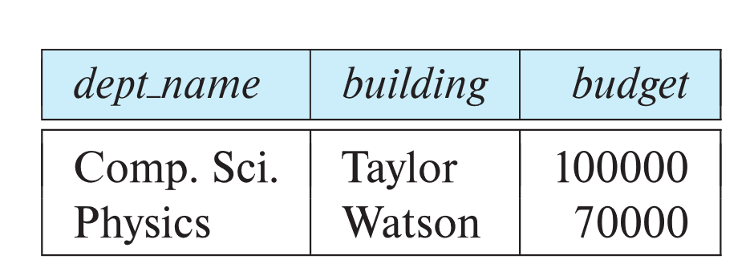
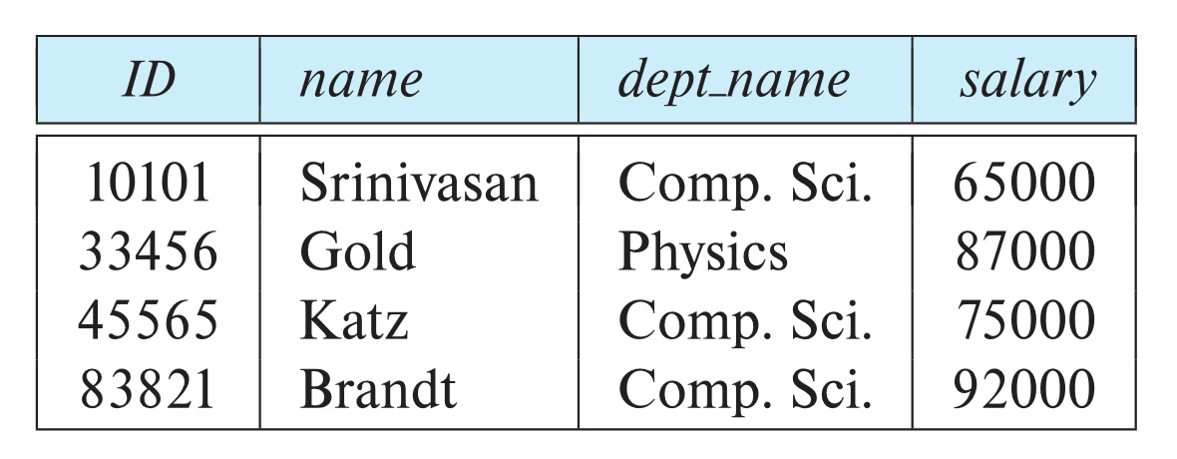
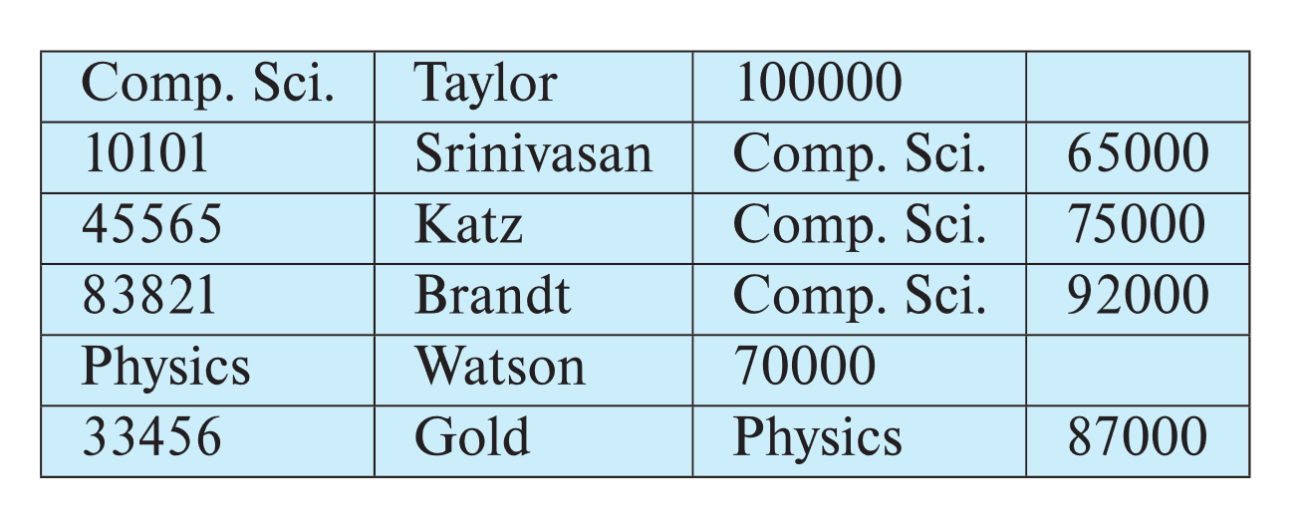
Multitable Clustering File Organization
department
instructor
multitable clustering
of department and
instructor

Slide 37
Multitable Clustering File Organization
good for queries involving department ⨝ instructor, and for queries involving one single department and its instructors
bad for queries involving only department
results in variable size records
Can add pointer chains to link records of a particular relation

Slide 38
Partitioning
Table partitioning: Records in a relation can be partitioned into smaller relations that are stored separately
E.g., transaction relation may be partitioned into transaction_2018, transaction_2019, etc.
Queries written on transaction must access records in all partitions
Unless query has a selection such as year=2019, in which case only one partition in needed
Partitioning
Reduces costs of some operations such as free space management
Allows different partitions to be stored on different storage devices
E.g., transaction partition for current year on SSD, for older years on magnetic disk

Slide 39
Data Dictionary Storage
The Data dictionary (also called system catalog) stores metadata; that is, data about data, such as
Information about relations
names of relations
names, types and lengths of attributes of each relation
names and definitions of views
integrity constraints
User and accounting information, including passwords
Statistical and descriptive data
number of tuples in each relation
Physical file organization information
How relation is stored (sequential/hash/…)
Physical location of relation
Information about indices (Chapter 14)

Slide 40
Relational Representation of System Metadata
Relational representation on disk
Specialized data structures designed for efficient access, in memory

Slide 41
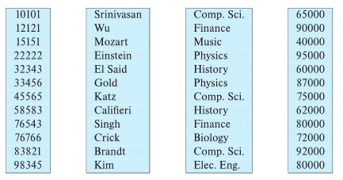
Column-Oriented Storage
Also known as columnar representation
Store each attribute of a relation separately
Example

Slide 42
Columnar Representation
Benefits:
Reduced IO if only some attributes are accessed
Improved CPU cache performance
Improved compression
Vector processing on modern CPU architectures
Drawbacks
Cost of tuple reconstruction from columnar representation
Cost of tuple deletion and update
Cost of decompression
Columnar representation found to be more efficient for decision support than row-oriented representation
Traditional row-oriented representation preferable for transaction processing
Some databases support both representations
Called hybrid row/column stores

Slide 43
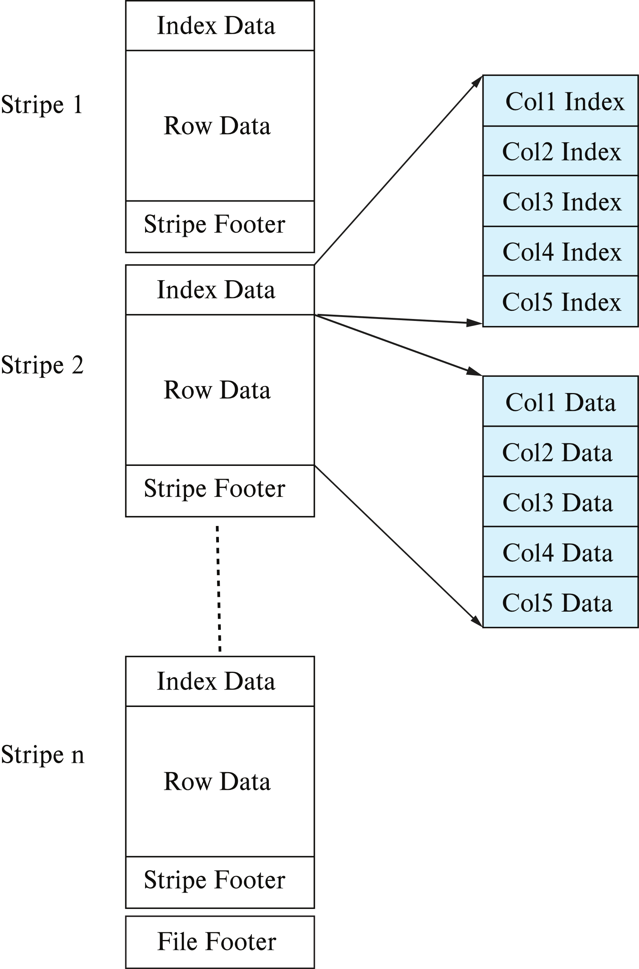
Columnar File Representation
ORC and Parquet: file formats with columnar storage inside file
Very popular for big-data applications
Orc file format shown on right:

Slide 44
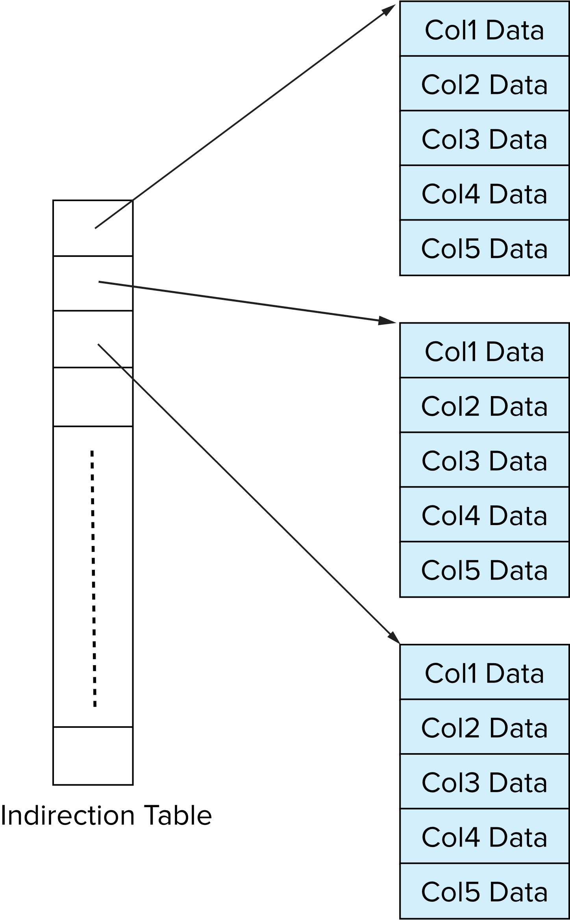
Storage Organization in Main-Memory Databases
Can store records directly in memory without a buffer manager
Column-oriented storage can be used in-memory for decision support applications
Compression reduces memory requirement

